Slide 1
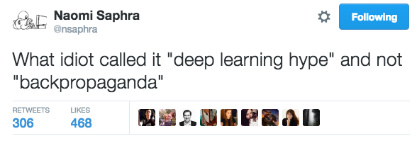
Active Research Areas
in Deep Learning for NLP
Sam Bowman
NYU DS-GA 3001

Slide 2
Announcements
Evaluation before class today
Meihao gone early (thanks Meihao!)
TA office hours: Tian
A4 questions/grading: Tian
Labs: Me

Slide 3
The rest of the semester
Tomorrow: Lab with me
Parsing + review – you bring the questions
Dec. 6: Final exam!
Usual place, usual time – 1h45 exam
No calculators/phones/printed notes/etc. – just a pen/pencil
If you understood the lectures and remember their key points, you should do fine
Dec. 7: Lab with me
Extra office hours for project help
Dec. 13: Legislative day, no meeting
Dec. 19: Paper due

Slide 4
There’s a lot we still can’t do
It will be all too easy for our somewhat artificial prosperity to collapse overnight when it is realized that the use of a few exciting words like in- formation, entropy, redundancy, do not solve all our problems.
Claude Shannon, on Information Theory
Most of the things a six-year-old can do with language are still far, far out of reach …
… but we’re making rapid progress!

Slide 5
Active methodological
research areas in DL for NLP
Any such list is inevitably both redundant and incomplete, but:
Words, characters, or morphemes?
Multi-hop attention and learning with structured memory
Deep reinforcement learning
Effective sentence representation learning
Low resource learning
Unsupervised learning above the word level
Interpretability
Common sense

Slide 6
Active methodological
research areas in DL for NLP
Any such list is inevitably both redundant and incomplete, but:
Words, characters, or morphemes?
Multi-hop attention and learning with structured memory
Deep reinforcement learning
Effective sentence representation learning
Low resource learning
Unsupervised learning above the word level
Interpretability
Common sense

Slide 7
Words, Characters,
or Morphemes?

Slide 8
The question
How do we represent spans of text as inputs or outputs for an NN model?
In other words:
What kinds of symbol should the encoder see?
What kinds of symbol should the decoder produce?

Slide 9
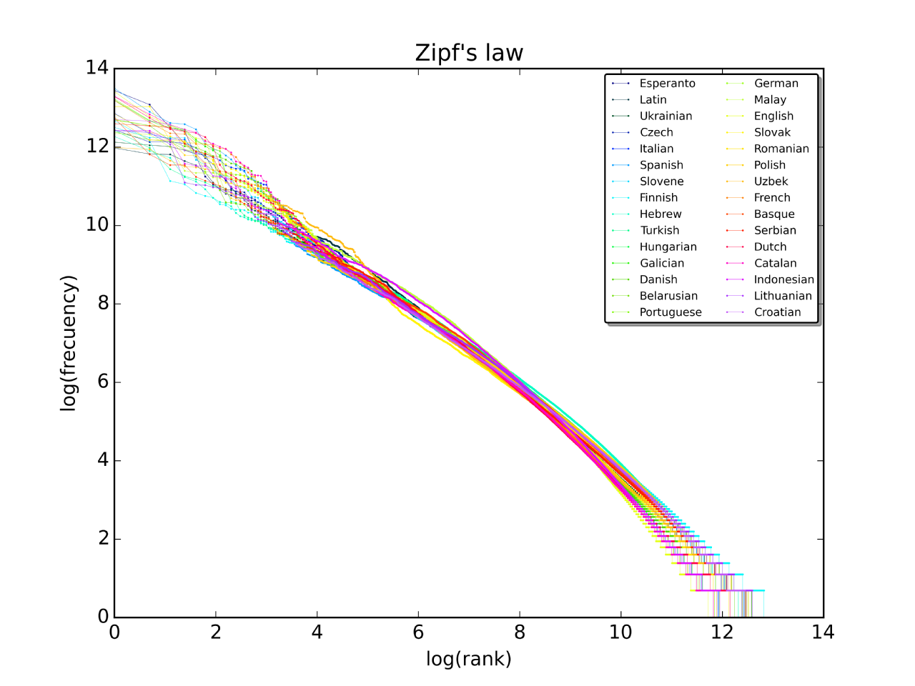
The problem with words
via Wikipedia

Slide 10
Words?
Advantages:
Tokenization is easy
Reasonably close to the basic unit of meaning
...if we ignore synthetic/morphologically rich languages.
Disadvantages:
Large vocabulary sizes

Slide 11
Morphemes?
Advantages:
Basic unit of meaning
Disadvantages:
Tokenization is difficult
Vocabulary sizes still large

Slide 12
Morphemes-ish? Byte pair encoding
Advantages:
Tokenization is easy
Vocabulary size can be tuned freely
Reasonably close to the basic unit of meaning
...if we ignore languages with infixing or complex morphophonology
Disadvantages:
Results mixed so far

Slide 13
Characters?
Advantages:
Tokenization is very easy
No rare word problem
Disadvantages:
Far from the basic unit of meaning
Word2vec-style unsupervised pretraining likely to be less effective
Too few parameters
Attention becomes expensive (too many tokens)

Slide 14
Recent Work

Slide 15
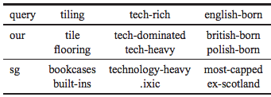
Character n-Gram Embeddings
Enriching Word Vectors with Subword Information Bojanowski, Grave, et al., arXiv ‘16
Unsupervised word learning with Skip-Gram
… but represent words as bags of character 3/4/5/6-grams
Great similarity/analogy performance w/ rare words

Slide 16
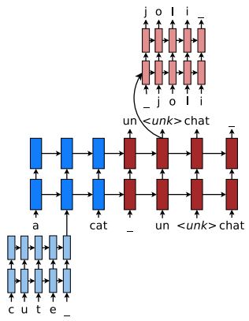
A Hybrid Model for NMT
Achieving Open Vocabulary Neural Machine Translation with Hybrid Word-Character Models Luong & Manning, ACL ‘16

Slide 17
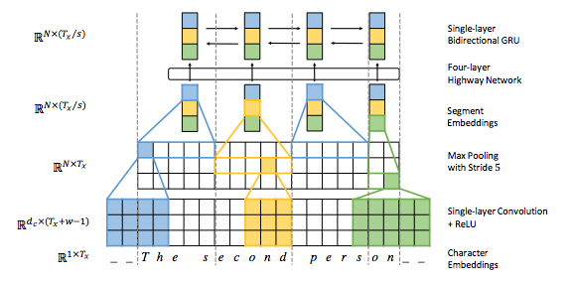
Characters + Pooling for NMT
Fully Character-Level Neural Machine Translation without Explicit Segmentation Lee et al., arXiv ‘16

Slide 18
Multi-Hop Attention and
Structured Memory

Slide 19
Handling large inputs
If your model needs to understand …
… a word or short window of words,
feed it in using an MLP.
… a sentence,
feed it in using an RNN/CNN/TreeRNN, maybe add attention.
… a short document,
a single vector probably isn’t enough,
and understanding it may require glancing around while reading,
and attention over large unstructured sets gets expensive.

Slide 20
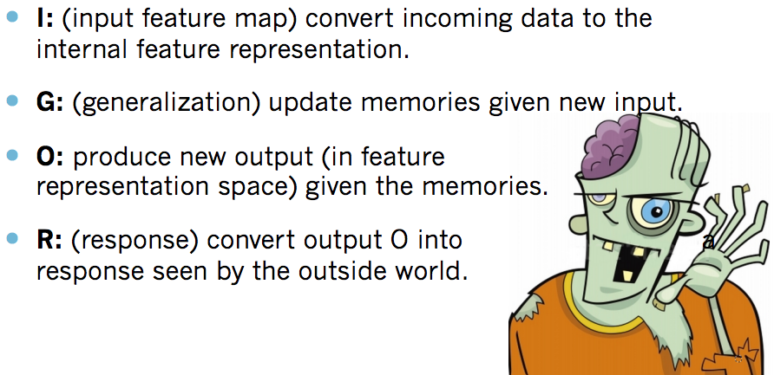
The Memory Network framing
(Jason Weston)

Slide 21
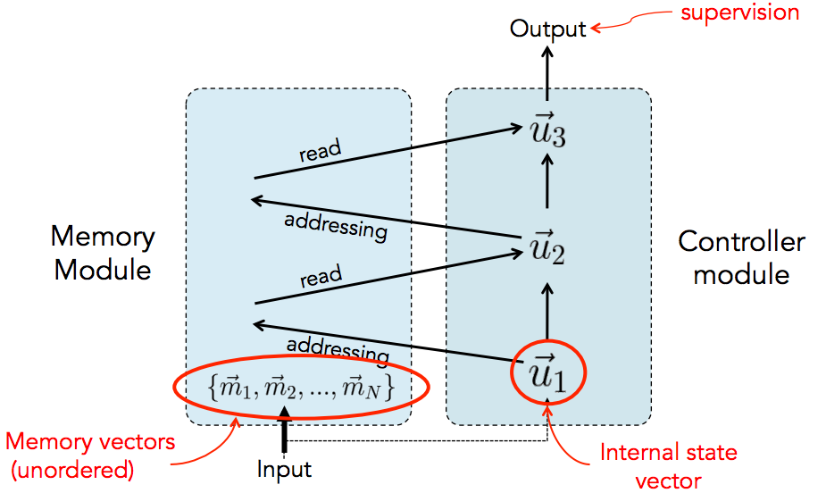
The original Memory Network
(Jason Weston)

Slide 22
Many variations!
Most recent work on reading comprehension involves some kind of structured memory.
CNN/DailyMail, WDW, SQuAD, CBT, SNLI (some instances)
Nearly arbitrary combinations of:
RNNs/CNNs over multiple inputs
Attention
Pooling
Clever gating/windowing
See also: More powerful/brittle Neural Turing Machine framing (Graves et al. ‘14)

Slide 23
Recent Work

Slide 24
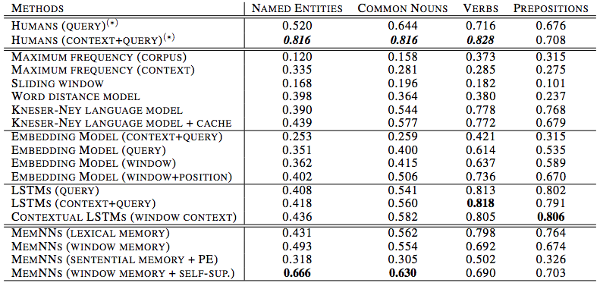
Memory Networks over 5-Grams for Story Comprehension
The Goldilocks Principle: Reading Children's Books with Explicit Memory Representations, Hill et al., ICLR ‘16

Slide 25
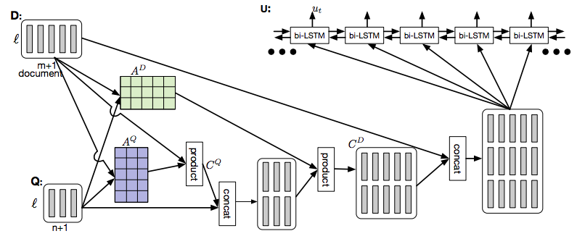
Attention + Attention + Incremental Output
Dynamic Coattention Networks for Question Answering Xiong et al., arxiv ‘16

Slide 26
Deep
Reinforcement Learning

Slide 27
Deep reinforcement learning
Reinforcement learning with distributed representations under the hood
What is reinforcement learning?
An alternative to fully supervised machine learning:
Take a sequence of actions:
Observe some information about environment
Take an action (produce an output)
Sometimes get scalar-valued reward from environment
Monitor what rewards you get so that you can pick more rewarding actions next time

Slide 28
Deep reinforcement learning in NLP
Most common setting in current research:
You’re doing supervised learning on some problem, but to solve the problem, your model needs to make a discrete decision for which no supervision is available.
Discrete decision = no gradients = no gradient descent learning
Reinforcement learning allows you to compute noisy approximate gradients
Methods:
Policy Gradient/REINFORCE/... (simple)
Q-learning/actor critic/... (more complex)

Slide 29
A motivating example: QA
Imagine you have to take Siri/Watson/etc.’s job for a day: answering arbitrary factual questions.
Reasonable recipe:
Read and understand the question.
Google something relevant to the question.
Skim the first few results.
If there’s a clear answer, you’re done.
If there isn’t, take what you’ve learned, use it to refine what you’re searching for, and repeat.

Slide 30
This is hard.
The reward might be non-zero for only a tiny set of possible actions (infinitely many wrong things to search for)
Need to get exploration/exploitation tradeoff just right
May need pretraining/good initialization strategies
You might get only one reward after a large number of actions
Credit assignment problem: Which actions helped you, which were irrelevant, which were actually harmful?

Slide 31
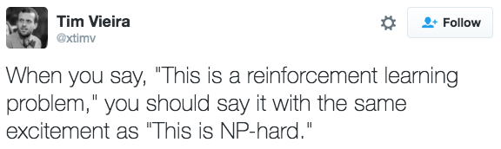
This is hard.
In practice, deep reinforcement learning for NLP is…
… unstable and difficult to tune.
… several orders of magnitude slower than backprop-based learning for a comparable number of parameters.
… the only way that we can reap the benefits of end-to-end training (if that’s what we want...) in many important NLP problems.

Slide 32
Recent Work
Warning: Murder/Suicide/Domestic Violence

Slide 33
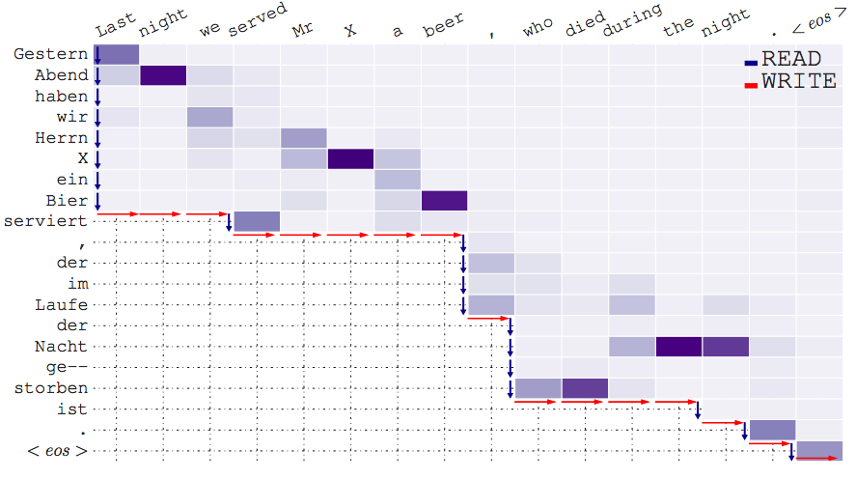
Real-Time Translation
Learning to Translate in Real-time with Neural Machine Translation Gu et al., arXiv ‘16

Slide 34
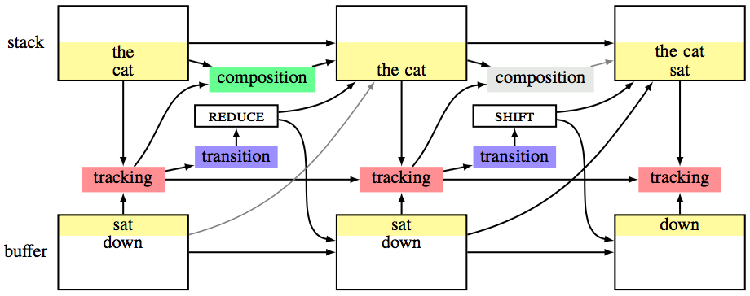
Parsing for Interpretation with SPINN and SNLI

Slide 35
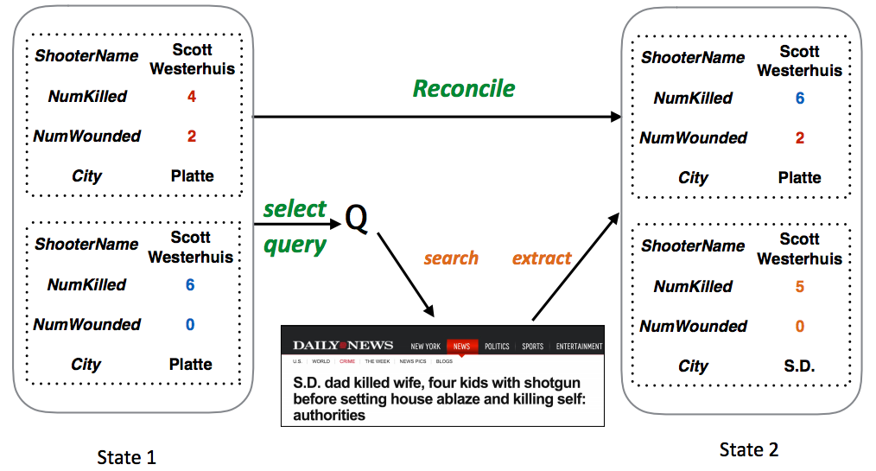
Information Extraction with Repeated Search Queries
Improving Information Extraction by Acquiring External Evidence with Reinforcement Learning, Narasimhan et al., ACL ‘16 (Best Paper)

Slide 36
Other Major Issues

Slide 37
Low-resource learning
This class has focused on English (lots of speakers/researchers/$) and on high-profile tasks (lots of researchers/$), so you might reasonably have gotten used to operating in a data-rich environment.
This is not usually the case.
Broad open issue: Operating with limited training data
Transfer learning and indirect supervision
Unsupervised learning

Slide 38
Interpretability
We’d like to know, in human-understandable terms:
What aspects of language does our model understand and use?
Why did our model make a specific decision?
Especially important for high-stakes decisions:
What if an automated resume-sorting system throws out your job application? Was it being discriminatory?
Similar issues in finance, standardized testing, law enforcement…
Currently, there’s a tradeoff:
Neural network models: Interpretation hard, can be misleading
Symbolic models: Interpretation fairly easy, but often less effective

Slide 39
Common sense knowledge and common sense inference
Knowledge:
Can dogs fly?
Inference:
I just went swimming in a body of water. Was the water carbonated or still? (h/t Zhang et al.: Ordinal Common-sense Inference)
Major issue in any serious error analysis for an NLU problem
Training data hard to come by (people rarely state the obvious)
Vision?

Slide 40
What about linguistics?
What can we learn from linguistics?
What can linguistics learn from NLP?
Every time I fire a linguist, the performance of the speech recognizer goes up.
(probably apocryphal, attributed to Fred Jelinek, 1988)

Slide 41
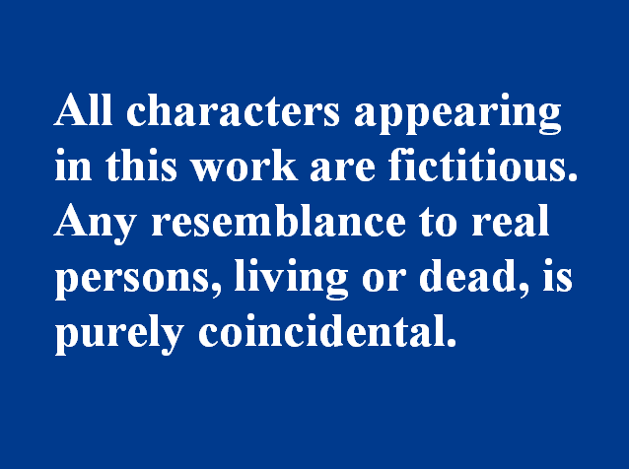
A closing reminder
neurons
designed solely to be useful tools
neurons

Slide 42
So, get to work!

Slide 43
Thanks!
Stay in touch!

